Slide 1

Phonics Workshop for Parents
6th January 2022

Slide 2
Early Learning Goals
– end of Reception Year
LITERACY
Comprehension
Demonstrate understanding of what has been read to them by retelling stories and narratives using their own
words and recently introduced vocabulary
Anticipate key events in stories
Use and understand recently introduced vocabulary during discussions about stories, non-fiction, rhymes and
poems and during role-play.
Word Reading
Say a sound for each letter in the alphabet and at least 10 digraphs
Read words consistent with their phonic knowledge by sound-blending
Read aloud simple sentences and books that are consistent with their phonic knowledge, including some
common exception words.
Writing
Write recognisable letters, most of which are correctly formed
Spell words by identifying sounds in them and representing the sounds with a letter or letters
Write simple phrases and sentences that can be read by others.

Slide 3

Overview
Term by term progression of GPCs (Grapheme Phoneme Correspondence).
Organised so that children are taught from the simple to more complex GPCs plus tricky words.
All the graphemes taught are practised in green words, sentences, and later on, in fully decodable books.
Review and revise GPCs and words, in order to move this knowledge into their long term memory.
Our expectations of progression are aspirational yet achievable - pace, practice and participation by all children.
Children are assessed very 6 weeks and grouped accordingly.

Slide 4
Reception RWI Overview
Baseline Assessment. | Phonemes m, a, s | Phonemes d, t, i | Phonemes n, p, g | Phonemes o, c, k | Phonemes u, b, f
Phonemes e, l, h | Phonemes/Diagraphs. sh, r, j | Phonemes v, y, w | Phonemes/Diagraphs. th, z, ch | Phonemes/Diagraphs. qu, x, ng | Phonemes/Diagraphs. nk Recap all set 1 graphemes.
Diagraphs ay | Diagraphs. ee | Diagraphs. igh | Diagraphs. ow | Diagraphs oo | Diagraphs oo
Diagraphs. ar | Diagraphs. or | Diagraphs. air | Diagraphs. ir | Diagraphs. ou | Diagraphs. oy
Revise all sounds – apply to writing.
Revise all sounds – apply to writing.

Slide 5
Year 1 RWI Overview
Diagraphs ea | Diagraphs ea | Diagraphs oi | Diagraphs a-e | Diagraphs i-e | Diagraphs o-e
Diagraphs u-e | Diagraphs aw | Diagraphs are | Diagraphs ur | Diagraphs er | Diagraphs ow
Diagraphs ai | Diagraphs oa | Diagraphs ew | Diagraphs ire | Diagraphs ear | Diagraphs ure
Diagraphs tion | Diagraphs Tious/cious | Recap all graphemes so far to consolidate.
Revise all sounds and apply to writing. Phonics Screening Test.
RWI Year 1 Spellings.

Slide 6
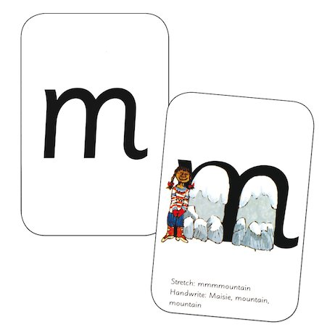
Every letter has a name
Every letter has a phoneme – sound
Every letter has a mnemonic – picture
Every letter has a formation phrase

Slide 7
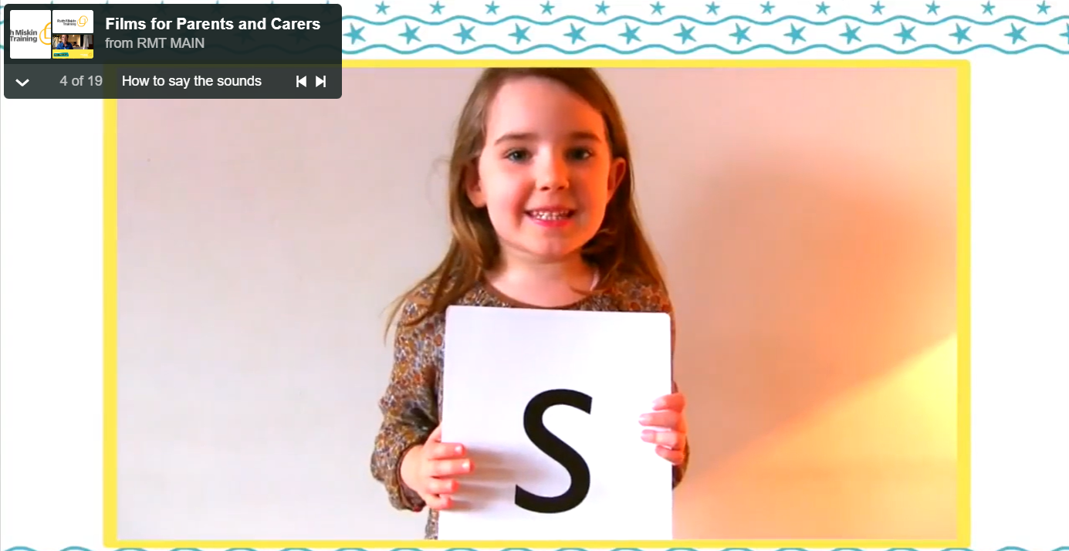
Pure Sounds
This video shows you how to pronounce the sounds. Notice how the children don’t add
an ‘uh’ sound at the end, so they say: ‘t’ not ‘tuh’.

Slide 8
Segmenting and Blending
Blending: Seeing a word and merging the phonemes together to read the word.
(Reading)
Segmenting: Chopping up a word into separate phonemes to spell it out.
(Writing)

Slide 9
CVC Words
CVC stands for consonant- vowel- consonant. These are words such as ‘map’, ‘cat’. We also talk about CCVC words such as ‘clip’, ‘stop’.
Cat
Consonant Vowel Consonant

Slide 10

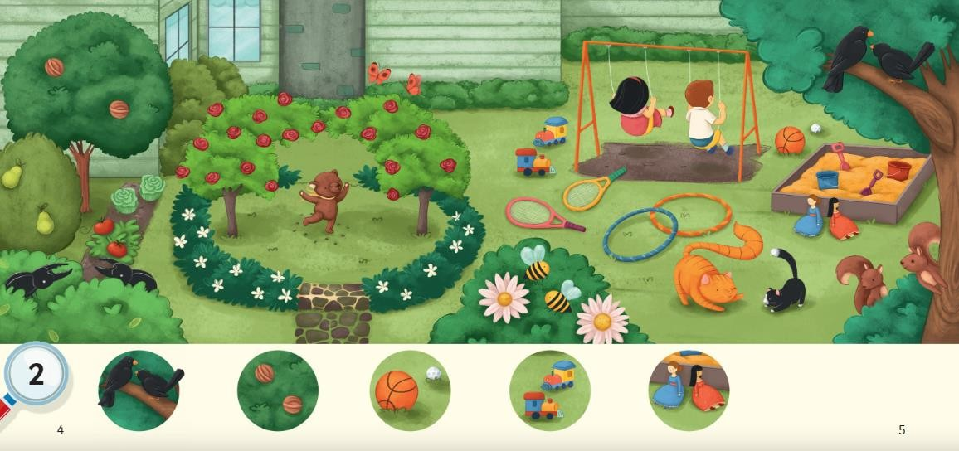
Books without words

Slide 11
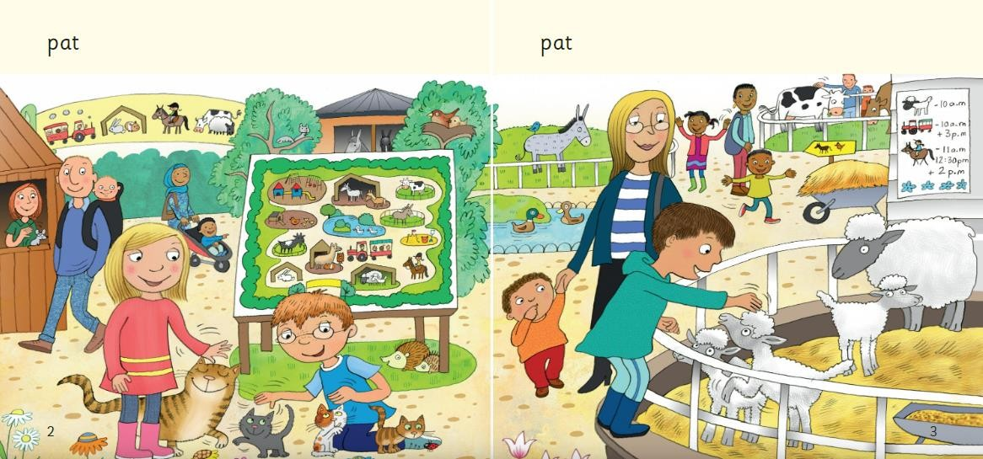

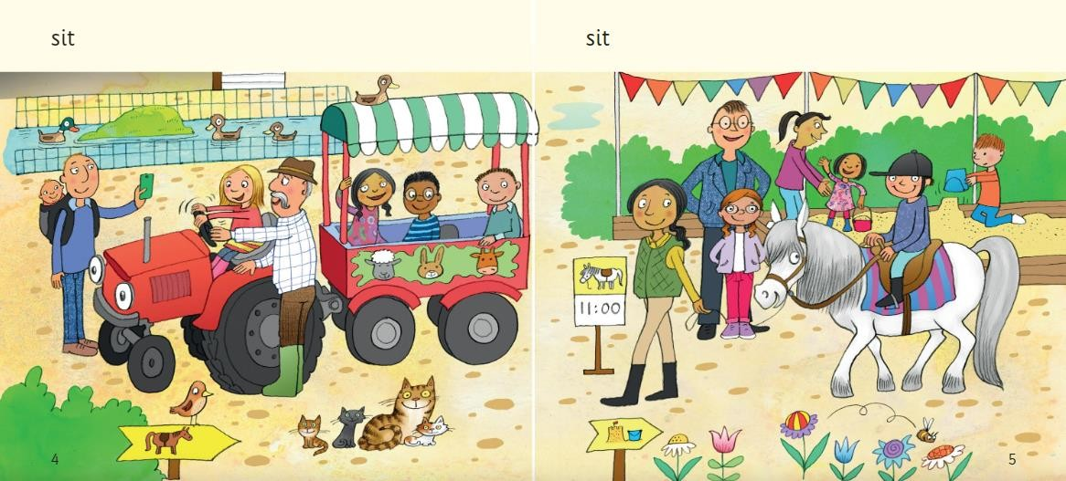
Books with words

Slide 12
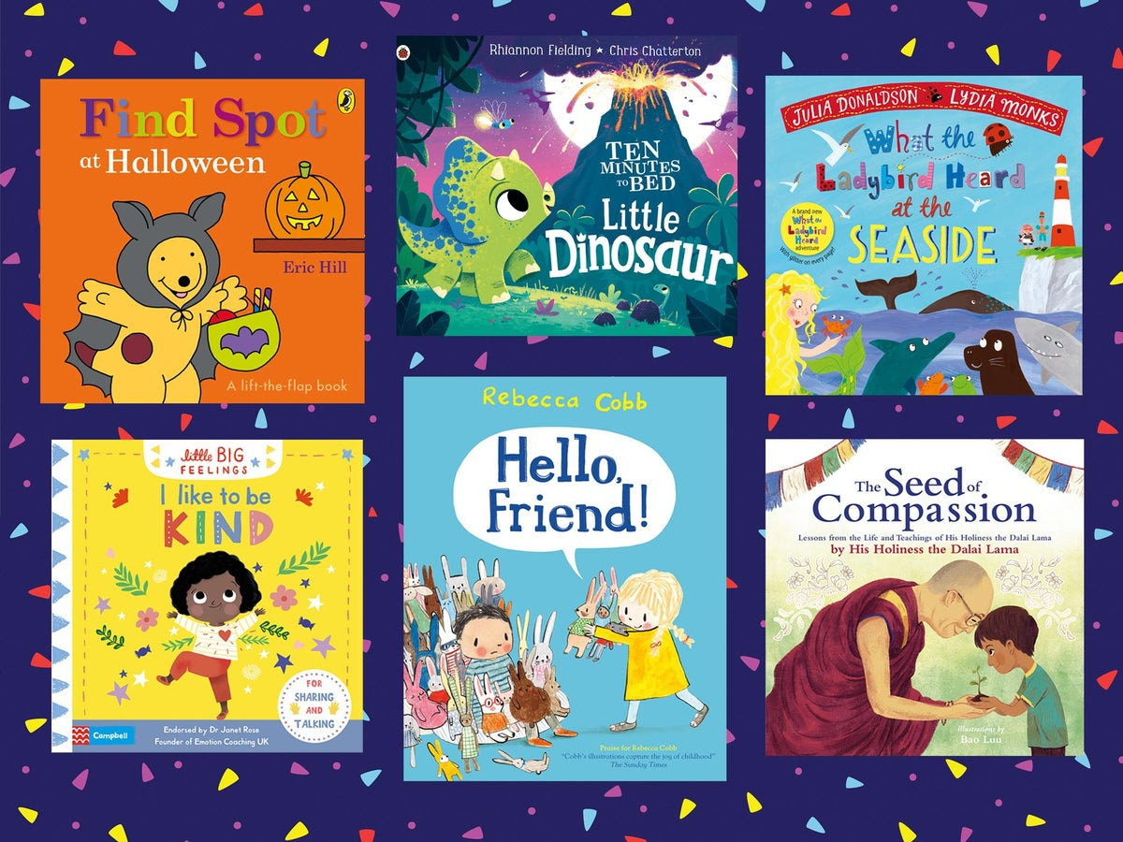
Early Reading
If children are to become lifelong readers, it is essential that they are encouraged to read for pleasure. The desire of wanting to read will help with the skill of reading.
Reading daily supports your child to practise their phonics knowledge as well as develop a love for reading.
Listening to stories and having stories read to them is also very important for developing essential skills.

Slide 13
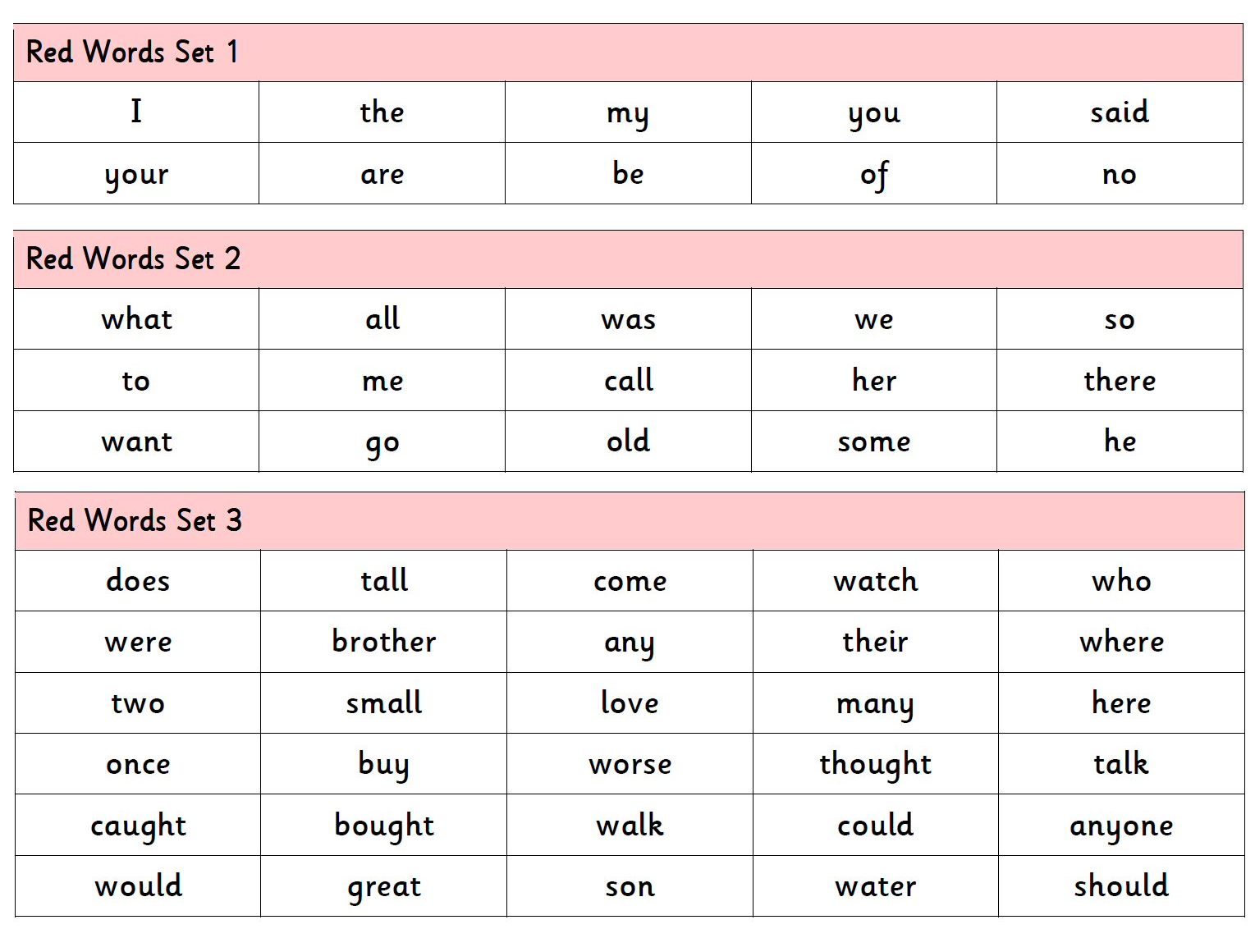
Tricky/Red Words
Red words are words that cannot be ‘sounded-out’ but need to be learned by heart. They don’t fit into the usual spelling patterns. In order to read simple sentences, it is necessary for children to know some words that have unusual or untaught spellings. It should be noted that, when teaching these words, it is important to always start with sounds already known in the word, then focus on the 'tricky' part.

Slide 14
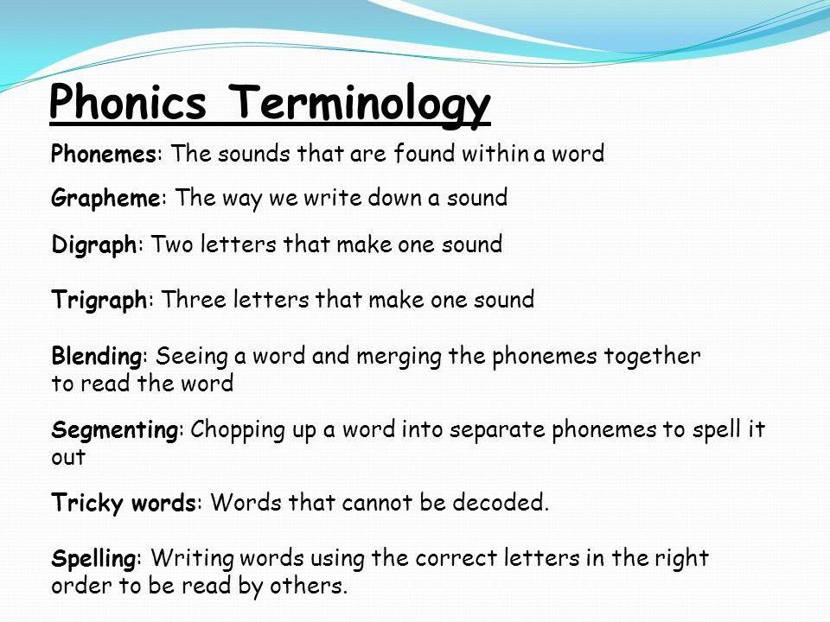

Slide 15
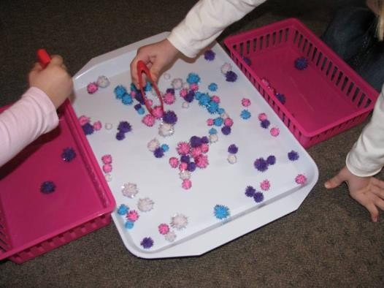
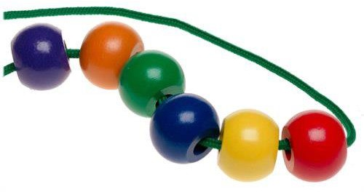
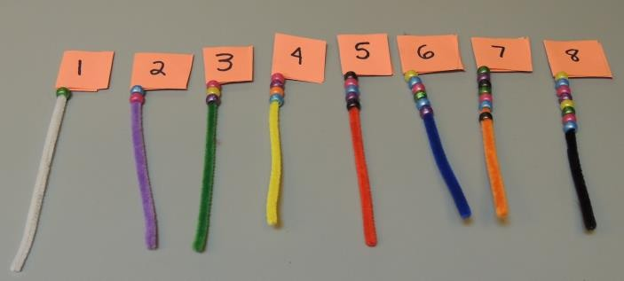

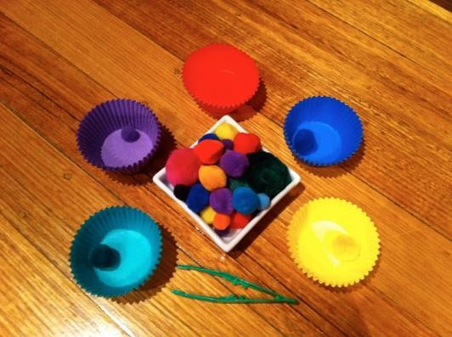
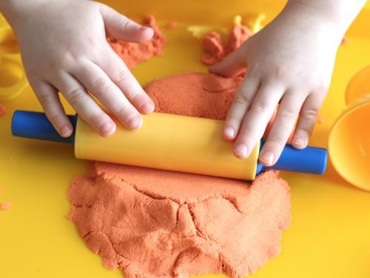
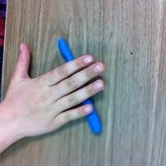
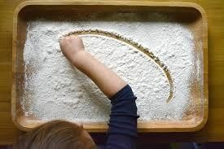
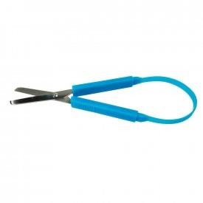
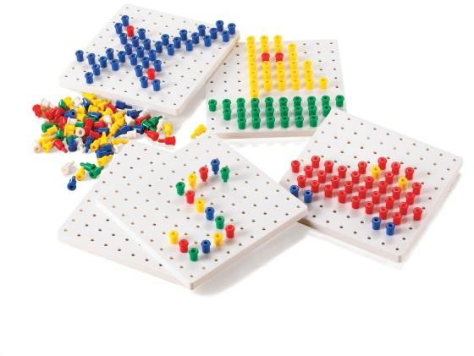

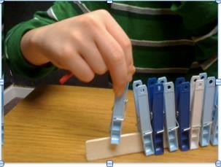
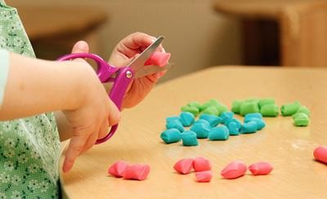
Strengthening their fine motor skills/ pre-writing skills

Slide 16
Please find below a link to the parents section on the Read Write Inc Website which has useful information and videos:
https://www.ruthmiskin.com/en/parents-copy-2/

