Slide 1
PSHE and Citizenship
Health and Wellbeing | Growing Up
PSHE and Citizenship | UKS2 | Health and Wellbeing | Growing Up | Let’s Talk About Sex | Lesson 5

Slide 3
The Big Questions

Slide 4



What is a sexual relationship and who can have one?
What is an STI and how can they be prevented?
What type of physical contact is unacceptable and how should we respond?

Slide 5
Reconnecting

Slide 6

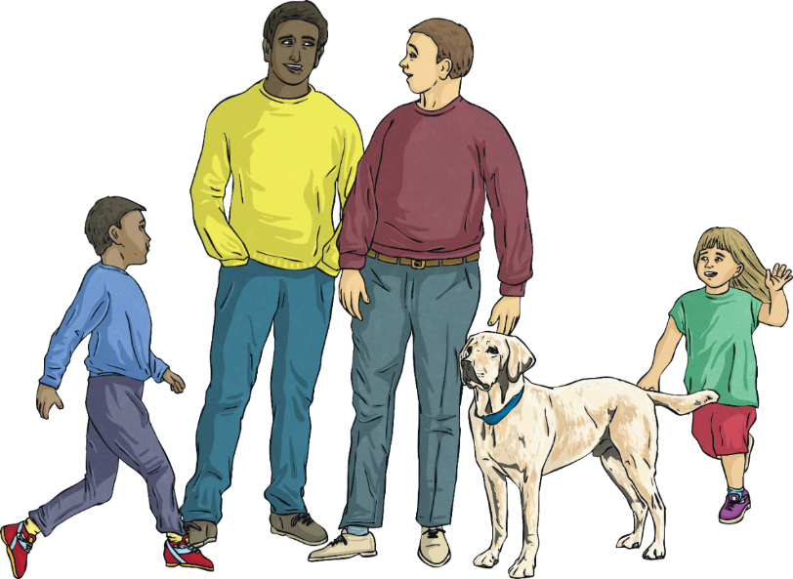
Relationships
Write down any questions you may have about sex on a sticky note.
Think back to the last lesson, which was all about different relationships.
What different types of relationship can you remember?

Slide 7

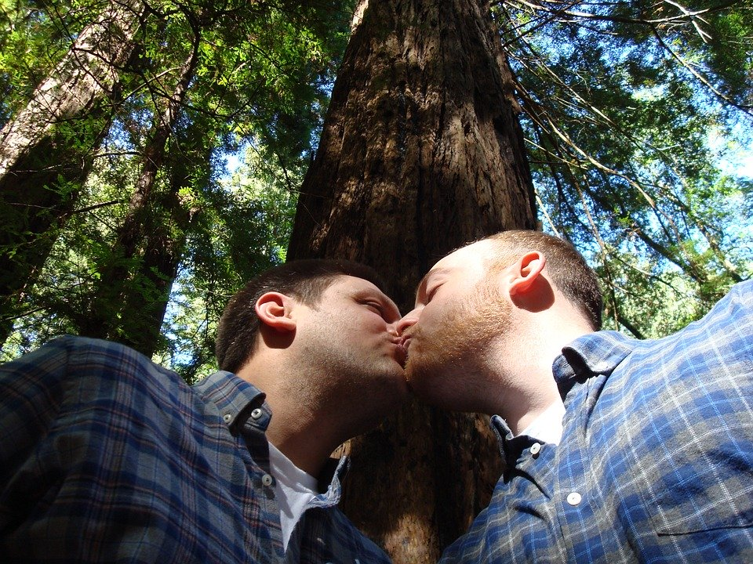


Relationships
Some adults choose to have a physically close, loving relationship with another adult.
There are heterosexual relationships (with someone of the opposite gender) and homosexual relationships (with someone of the same gender).

Slide 8


Relationships
You might have also heard the term ‘bisexual’. This describes a person who is attracted to men and women.
Someone who is ‘asexual’ isn’t interested in having a physical relationship with anyone. They are not sexually attracted to others.

Slide 9
Exploring

Slide 10

Let’s Talk About Sex
What Is ‘Sex’?
We may hear the words 'sex', 'sexy' and 'sexual' in everyday life, especially in modern pop songs or in films, but what does it actually mean?
The term ‘sex’ can refer to biological sex - whether someone is female or male.
It can also refer to the physical activity in which people touch each other's bodies and cuddle and kiss each other, which may lead to sexual intercourse.

Slide 11
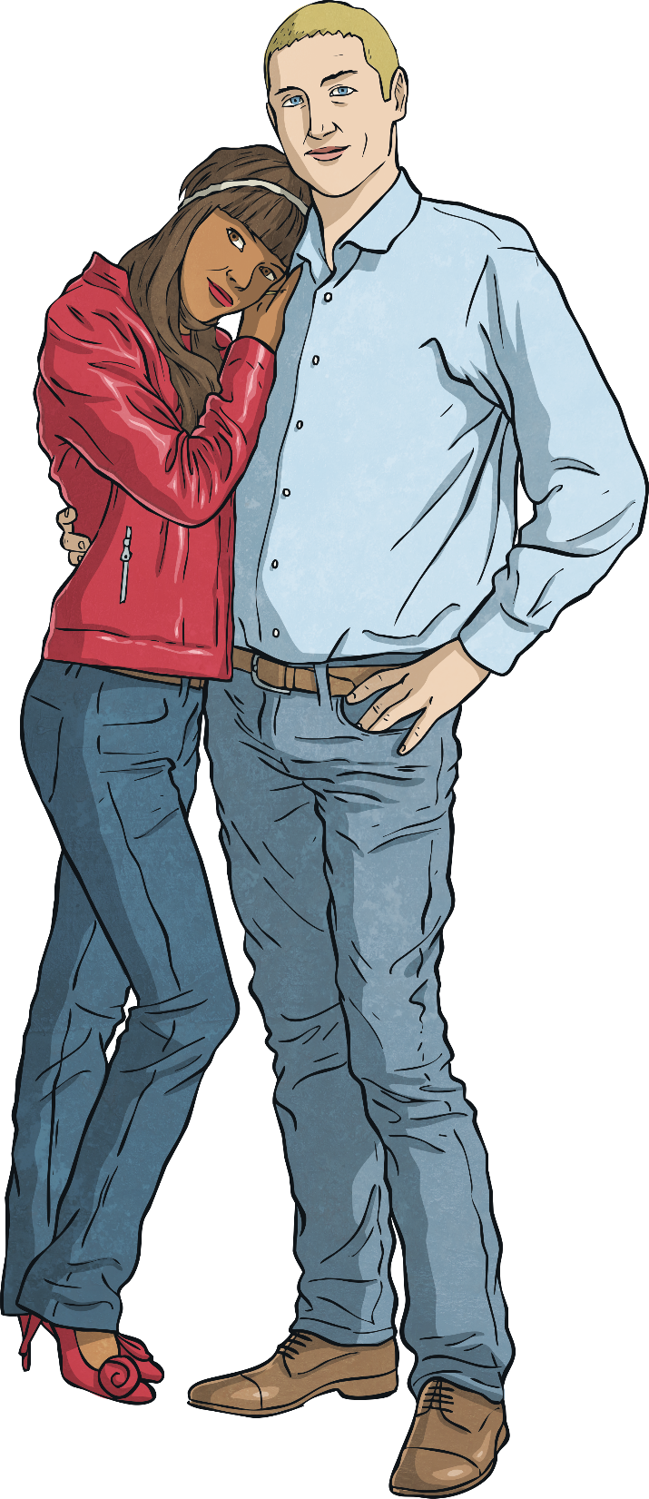
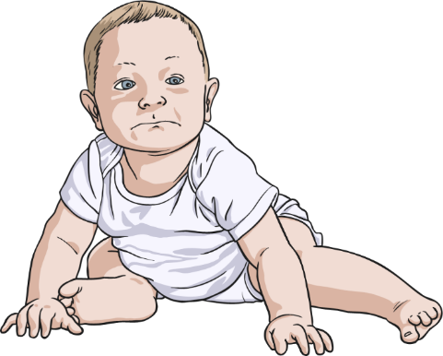
Let’s Talk About Sex
Why Do People Have Sex?
Sexual intercourse, or ‘sex’ for short, is one way that two adults in a loving relationship may show their love for one another.
It is also the start of the reproduction process, when a couple want to make a baby.

Slide 12
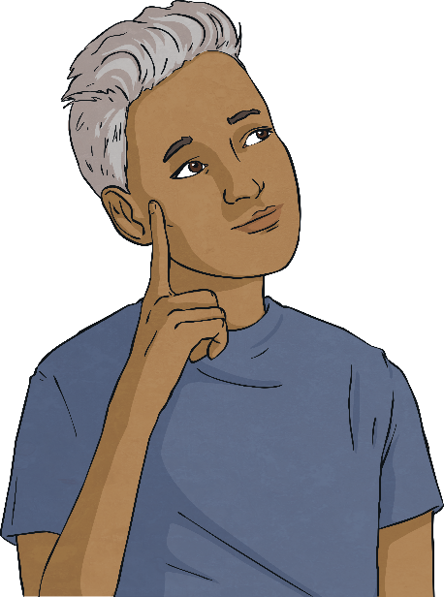
Let’s Talk About Sex
Sex and the Law
In the UK, the legal age that people can have sex is 16 years old.
Both people in the sexual relationship must be 16 years old or over.
Both people must consent - this means that both people want to have sexual intercourse. If one person forces another person to have sex, it is called rape. Rape is against the law.
In most modern societies, it is illegal for two people who are closely related to each other to have a sexual relationship, such as having sex with a parent, child, brother, sister or grandparent. This crime is called incest.
Why do you think these laws exist?

Slide 13

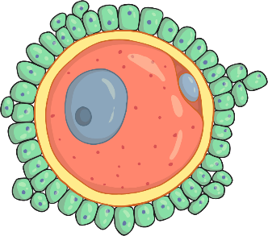
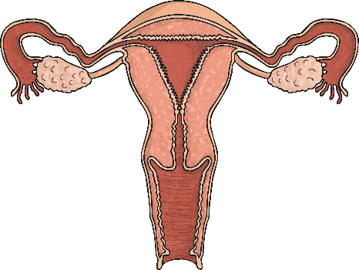
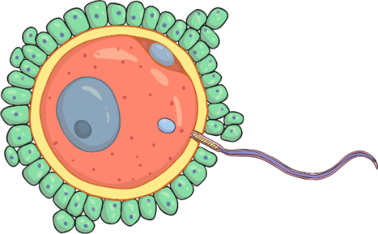

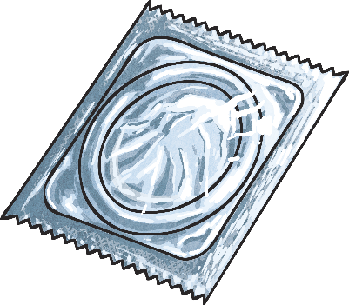
From Conception to Birth
If a male and a female want to conceive a baby, they have sexual intercourse. The male’s penis ejaculates sperm, which race to find the female’s egg.
The female’s body releases one egg, once a month. The egg only lives for about 12 – 24 hours but sperm can live for 5 – 7 days.
If a sperm reaches the egg, the egg is fertilised, starting a new life form.
If the couple do not want to conceive a baby, they can use contraception, such as a condom, to stop the sperm reaching the egg.

Slide 14

From Conception to Birth
Some couples conceive a baby differently. Same-sex couples and some heterosexual couples are not able to conceive a baby in this way.
Doctors can remove a female’s eggs from her body and the eggs can be fertilised with sperm outside of the body.
Once an embryo has formed, the doctors can place it back inside the female’s uterus so she can continue the pregnancy until the baby is ready to be born.

Slide 15
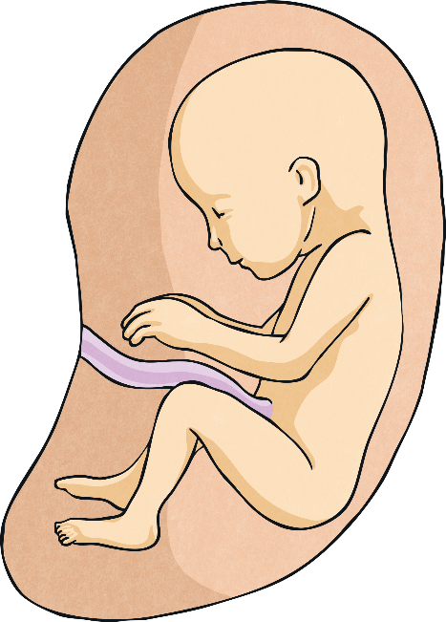
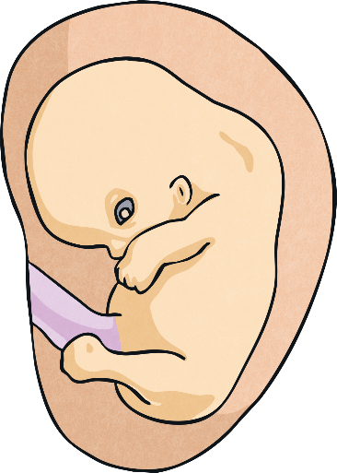
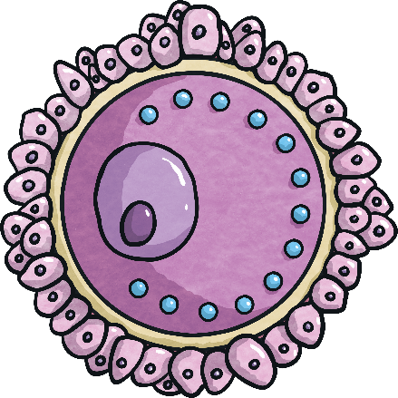
From Conception to Birth
Wow! From just two cells (a sperm and an egg) to 37.2 trillion cells in a human being!
zygote
embryo
foetus
The rate of growth is extremely rapid. The egg cell measures 0.12mm in diameter and a newborn baby is approximately 50cm.

Slide 16

Let’s Talk About Sex
Media, such as pop songs and television programmes, would have us believe that everyone is having sex and that being ‘sexy’ is
really important!
In reality, this is not the case. Two people, who are 16 or over, may decide to have sexual intercourse if they are attracted to one another and both feel ready to be physically close in this way.
Having a ‘crush’ on someone or fancying them is normal. It might be someone you think is good looking or who you admire. It might be someone you know or someone you have never met (like a celebrity). It doesn’t mean you love them and it doesn’t mean you want to have sex with them.
As you go through puberty and your body and emotions change, you may start to feel sexually attracted to others.

Slide 17
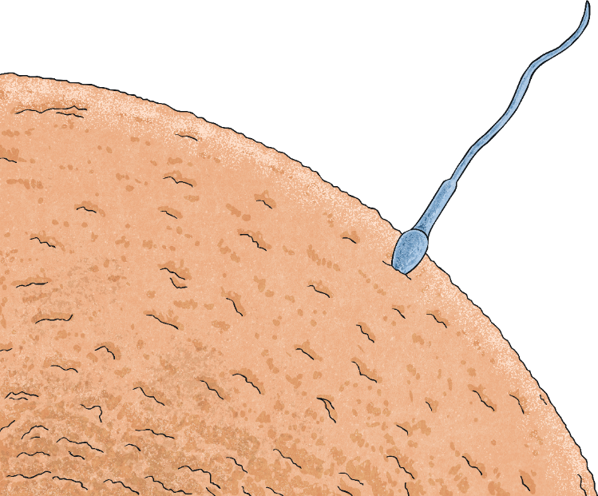



Let’s Talk About Sex
Sexual intercourse is also necessary for reproduction (in other animals, as well as humans). It is how the sperm meets the egg, as you might remember from other lessons.
Although sexual intercourse doesn’t always mean that a baby will be conceived (made), it might. If a heterosexual couple want to have sex but do not want to make a baby, they can use contraception to stop the female becoming pregnant.
Contraception methods include condoms, which the man wears on his penis to catch the sperm, or a pill that a woman takes to prevent her ovaries from releasing an egg. If there is no egg to be fertilised, the woman can’t get pregnant.

Slide 18

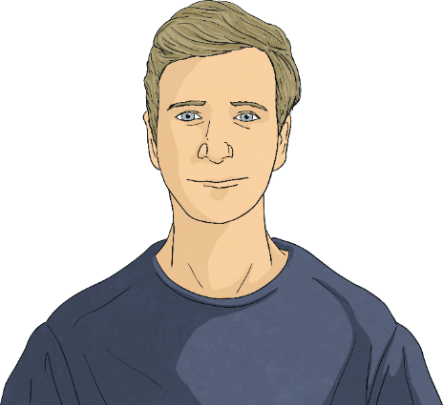

Staying Safe and Healthy
Just as we can share germs by sharing a drink with someone or by sneezing near them, infections can be passed from one person to another through sexual intercourse – this happens through bodily fluids, such as sperm.
There are several sexually transmitted infections (commonly known as STIs). Some can be very serious and make people very ill.
Using contraception, such as a condom, prevents an infection being passed from one person to another when they have sex. Not all forms of contraception protect against these diseases though. For example, the contraceptive pill would not protect someone from sharing an infection with their partner.

Slide 19
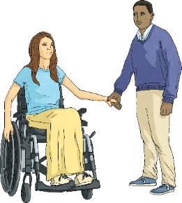
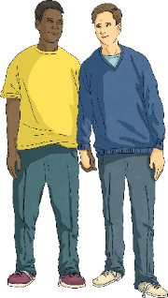
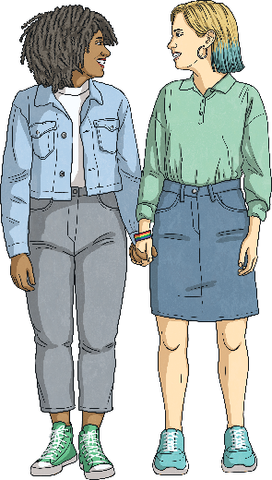


Staying Safe and Healthy
Looking after your body and protecting yourself against sexually transmitted infections (STIs) is an important part of staying safe and healthy when you
are older.
You wouldn’t know by looking at someone if they had an STI. They may not even know themselves! Knowing the other person very well and trusting them is as important as using protection (e.g. a condom).
Taking care and making sensible choices in a sexual relationship is called having ‘safe sex’. This includes being able to say ‘no’ to something you don’t want to do, even if you love the other person.

Slide 20

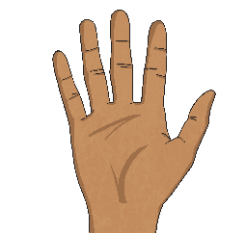
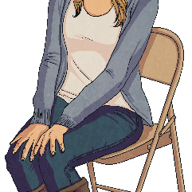
Staying Safe and Healthy
Staying safe also refers to being in charge of what happens to your body. Your body is your own and no one else can touch it without
your consent.
Some parts of our body are private, such as the genitals and the mouth. If someone ever tries to touch you in a place on your body that you are not comfortable with, or in a way that does not feel right, you must tell them to stop, say it is not appropriate and push them away. You should then tell a trusted adult straight away so that it doesn't happen again.
It's never your fault if somebody touches you in a way that makes you feel uncomfortable and it's very important that you tell someone so that they can help to keep you safe.

Slide 21
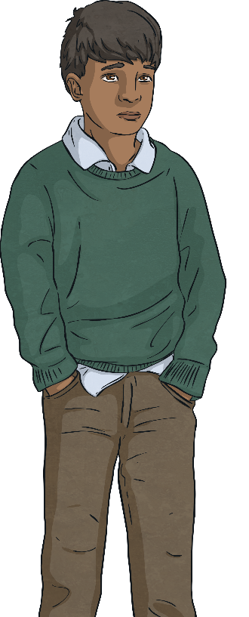
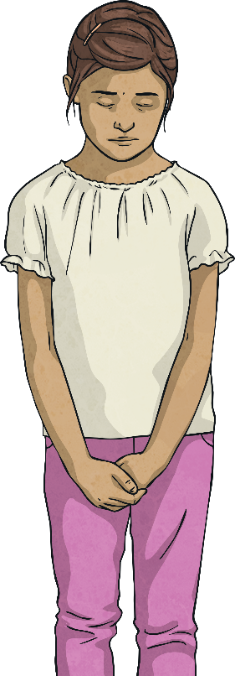

Staying Safe and Healthy
It can be difficult to speak up sometimes when we don't feel safe or when someone has made us feel uncomfortable. Being brave enough to speak up takes a lot of courage but it's really important that we do, so that someone can help.
0
8
0
0
1
1
1
1
Some children phone Childline on 0800 1111 when they need to talk about something that has happened. When children call this number, a person answers whom they can trust. By calling Childline, they can get the support and advice they need to report or deal with whatever has happened.
1
2
3
4
5
6
7
8
9
#
0
*

Slide 22
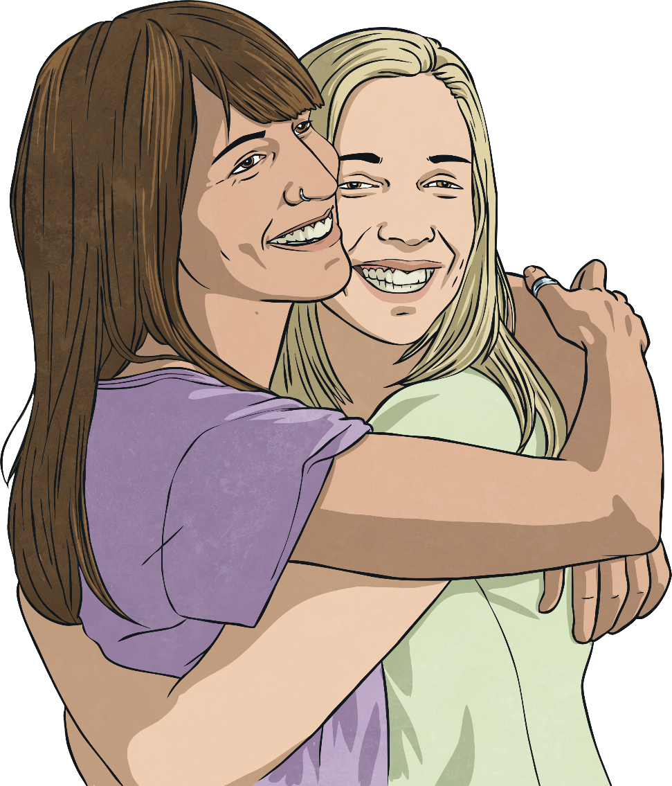
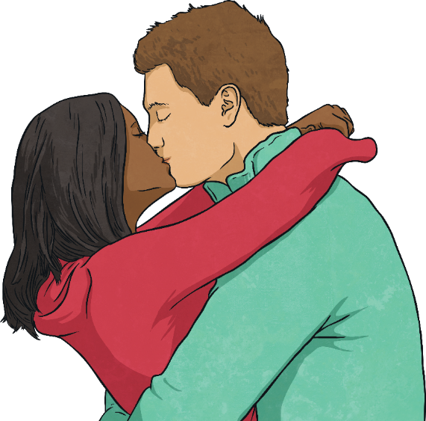
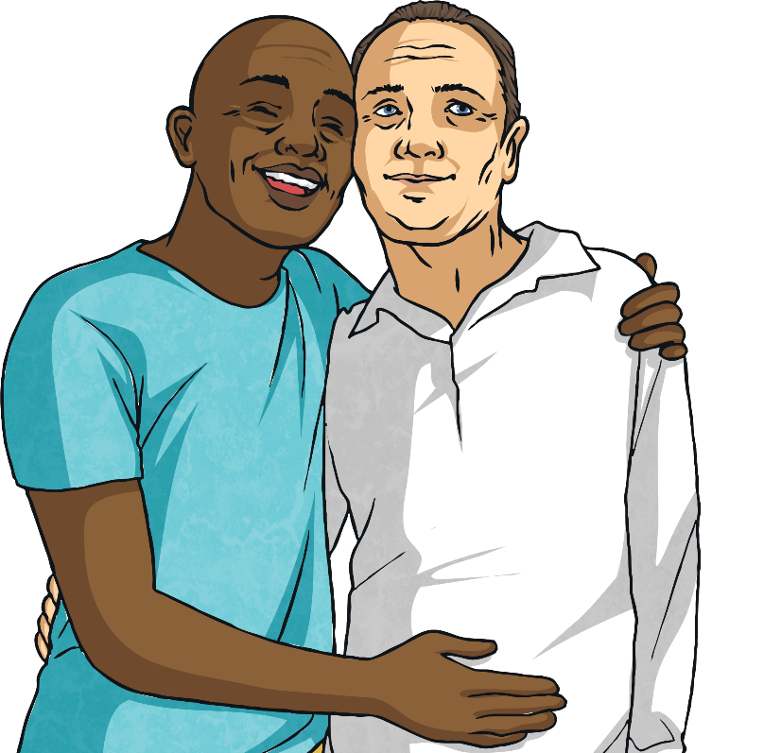





Staying Safe and Healthy
Remember
Both people must consent to sexual intercourse.
Sexual intercourse is something many adults enjoy when both people feel ready.
The legal age to have sexual intercourse for both people is 16.
If anything in a relationship ever makes you feel uncomfortable, you always have to right to say ‘no’ and stop.
It’s never OK to pressure or persuade someone else to be physically close if they don’t wish to be.
Two consenting adults may choose to have sex for different reasons, but they both have the right to feel comfortable, happy and safe.

Slide 23
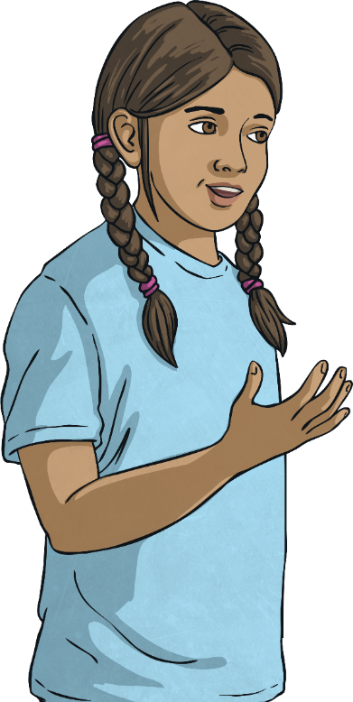
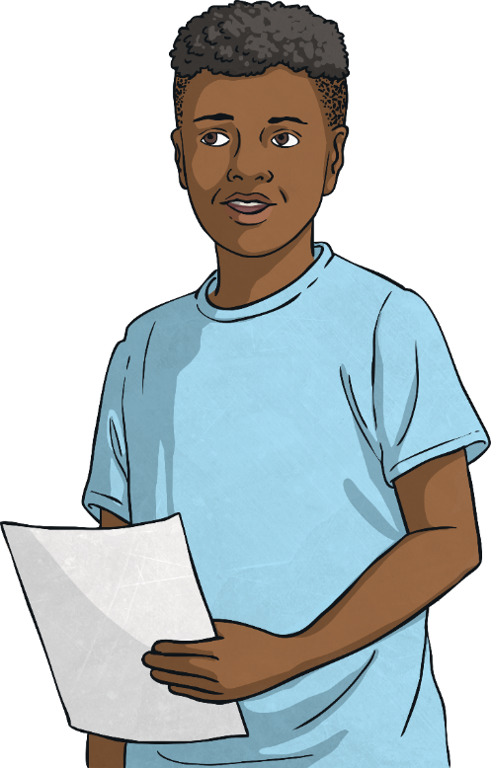
Consolidating
Reflecting

Slide 24
Consolidating

Slide 25
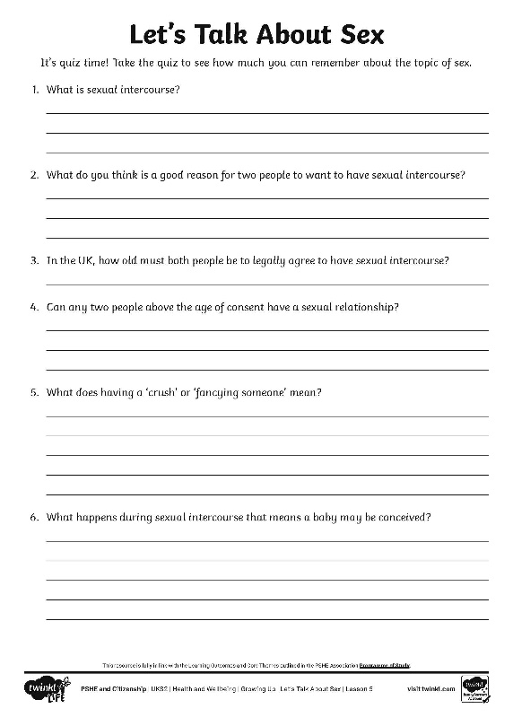
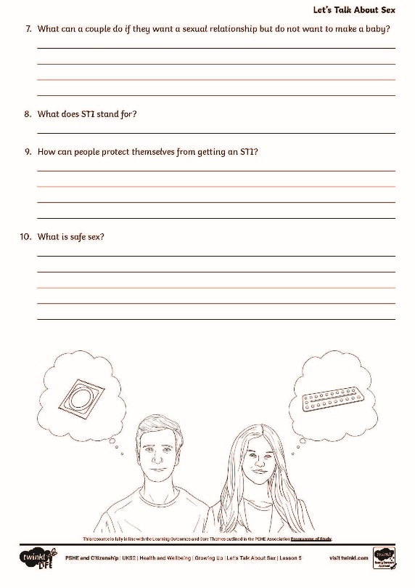
Take the Quiz
It’s time to get thinking about what you have learnt about sex!
Think carefully about the questions on your quiz sheet.
Try to answer using the
correct scientific vocabulary used in the lesson.

Slide 26
Reflecting

Slide 27

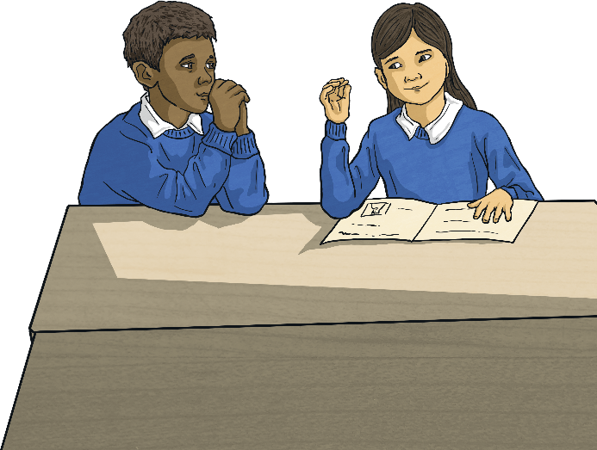

Questions and Answers
With your partner, look back at your questions from the start of the lesson.
Together, decide whether these questions have been answered in today’s lesson.
Perhaps you are able to answer your partner’s question for them.
If you still have questions you would like answered, put them in the Question Box at the end of the lesson and we can come back to these another time.
With your partner, write down three things that you have learnt today.

Slide 28
The Big Questions

Slide 29
What is a sexual relationship and who can have one?
What is an STI and how can they be prevented?
What type of physical contact is unacceptable and how should we respond?

Slide 30
Aim
I understand what a sexual relationship is and who can have a
sexual relationship.
Success Criteria
I can describe the terms ‘sexual relationship’ and ‘sexual intercourse’.
I can explain who can have a sexual relationship, according to
the law.
I can explain what an STI is and I know how these can be prevented.
I can judge when physical contact is unacceptable and I know how
to respond.

