Slide 1
PSHE and Citizenship
Health and Wellbeing | Growing Up
PSHE and Citizenship | UKS2 | Health and Wellbeing | Growing Up | Changing Bodies | Lesson 1

Slide 3
Aim
I can describe the changes that people’s bodies go through during puberty and how we can look after our changing bodies.
Success Criteria
I can use scientific vocabulary when talking about the human body.
I can discuss changes my body will go through and I know what
to expect.
I can explain how to look after my changing body.
I can explain how to protect my body and stay safe.
This resource is fully in line with the Learning Outcomes and Core Themes outlined in the PSHE Association’s Programme of Study.

Slide 4
The Big Questions

Slide 5

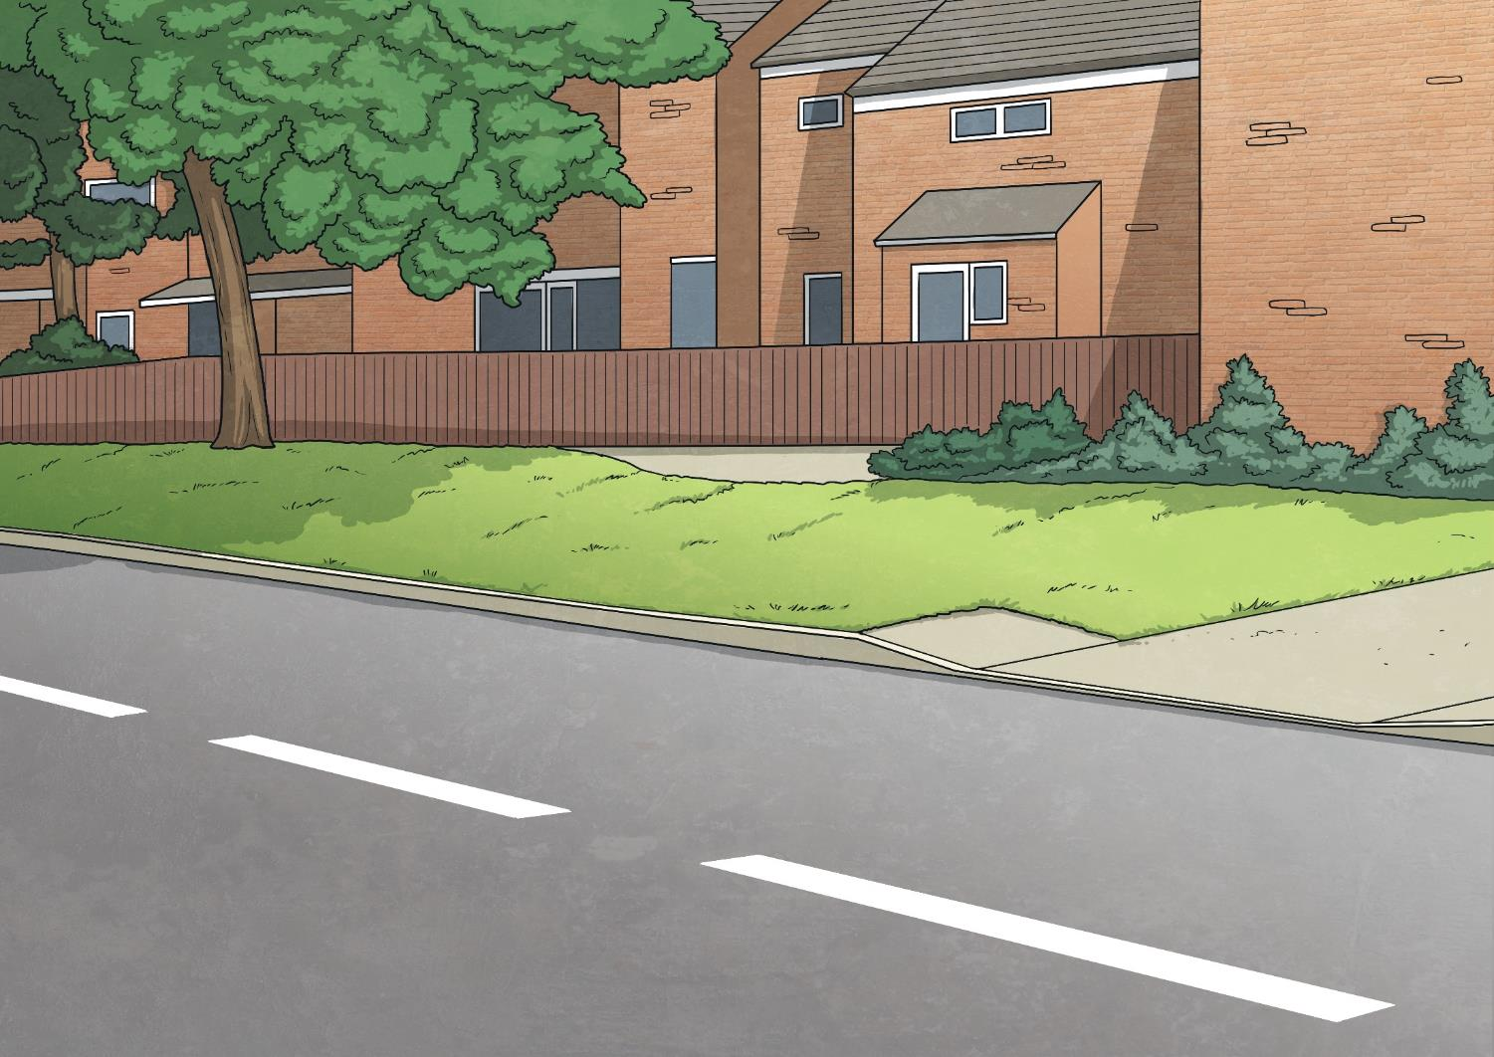

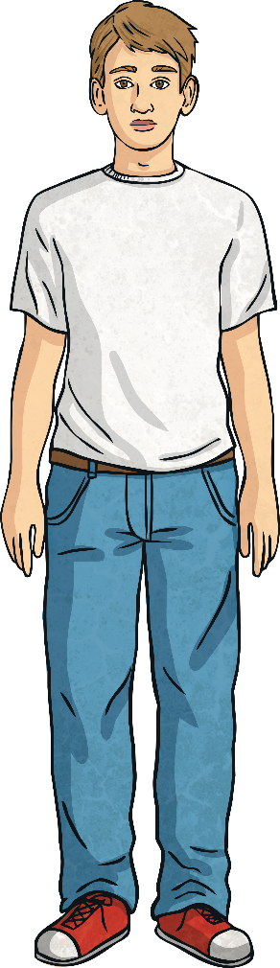
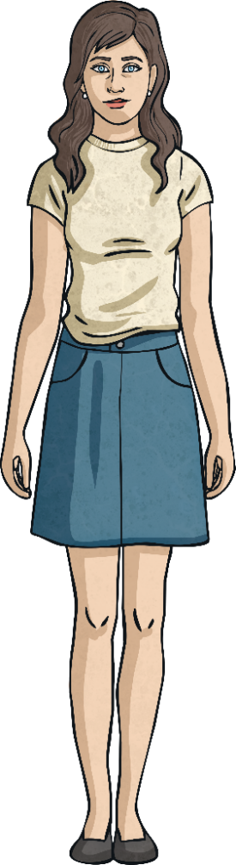
What are the changes that occur in boys’ and girls’ bodies during puberty?
How can we look after our changing bodies as we grow?

Slide 6
Reconnecting

Slide 7

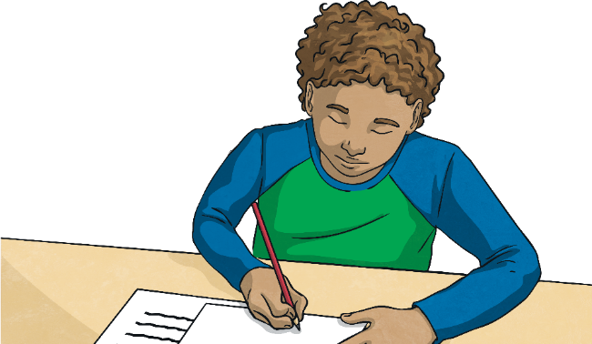
Puberty
Today we will be learning about how peoples’ bodies change as they go through puberty.
Write down what you already know about puberty. Think back to previous learning about how our bodies change as we grow.
On the pieces of paper provided, write down any questions you have about puberty that you would like answered in this lesson or at a
later date.

Slide 8

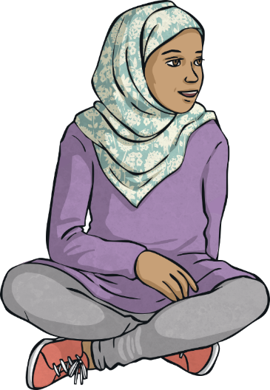
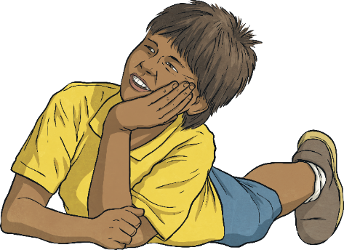
Puberty
Talk to your talk partner about the changes you have listed.
Which changes do you think both males and females go through during puberty?
With a partner, list the changes you think people might go through during puberty.
How might young people feel when their body starts to change?

Slide 9
Exploring

Slide 10

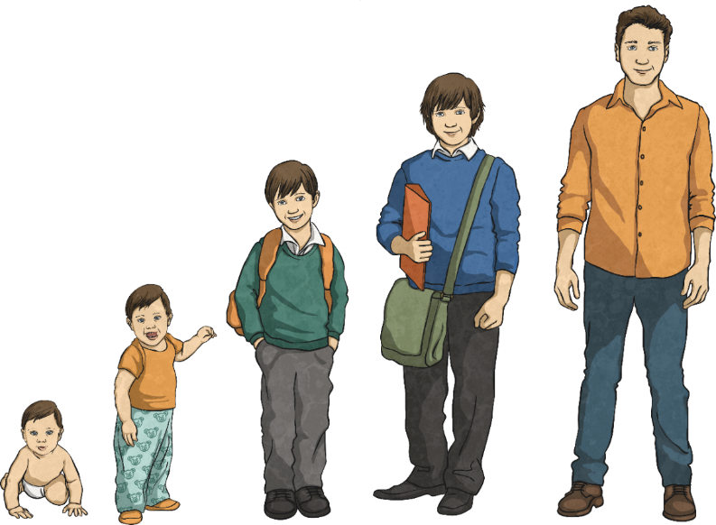
How Bodies (and Emotions)
Can Change During Puberty
What is puberty?
Puberty is the word to describe the phase when a child’s body starts to change as they become an adult.
Apart from when you were a baby, this is the time when your body will grow
the fastest.

Slide 11
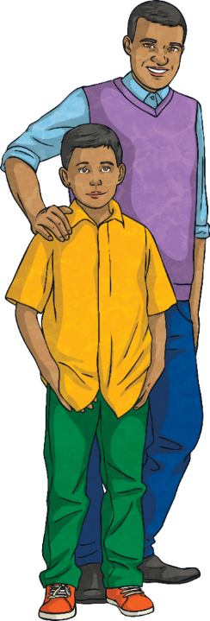
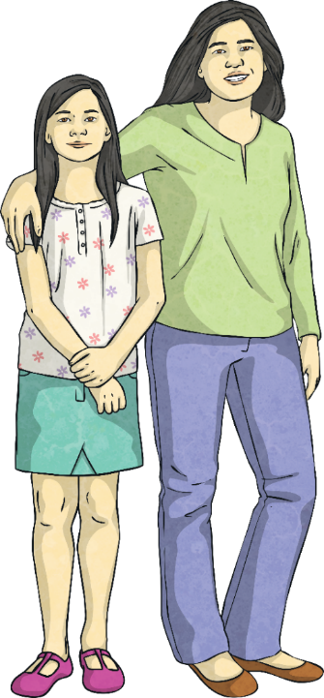
How Bodies (and Emotions)
Can Change During Puberty
So, what sorts of changes should we expect?
How does a boy become a man and how does a girl become a woman?

Slide 12
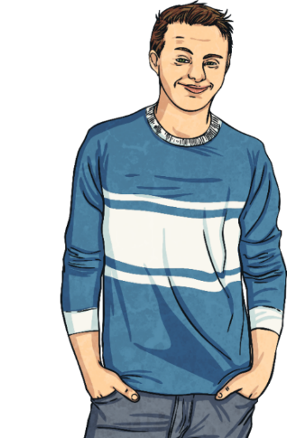

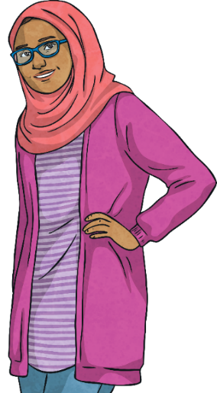
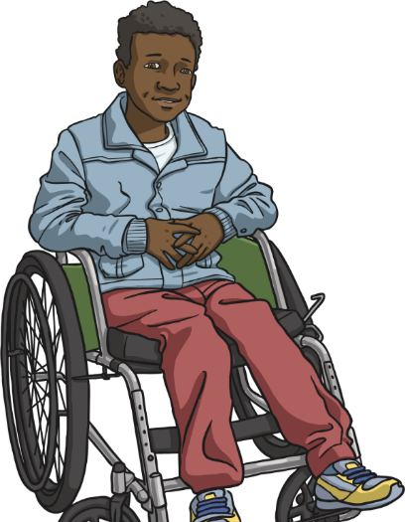
How Bodies (and Emotions)
Can Change During Puberty
It helps to know about the changes your body will go through before they happen so you know what to expect.
It is important to remember that everyone goes through these changes, no matter who they are, what they are like or where they live.
We are all different but we all go through puberty!

Slide 13
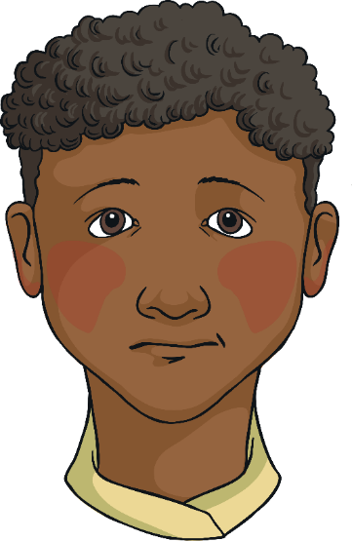
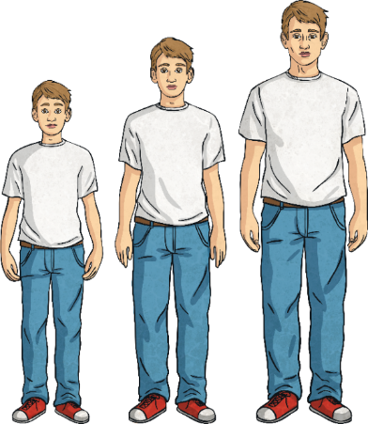


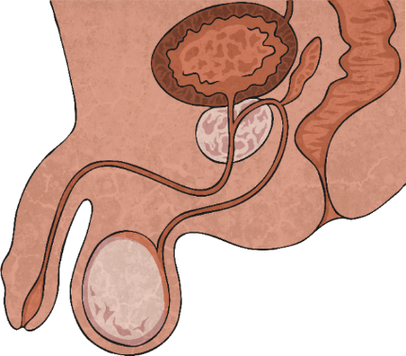
How Bodies (and Emotions)
Can Change During Puberty
Puberty usually starts between the ages of 9 and 15 in males.
Let’s take a look at some changes that happen in the male body
during puberty…
Boys might notice that their penis sometimes becomes hard. This is called an erection. It can be embarrassing but don't worry, it is completely normal and it will happen less and less as you
get older.
Boys’ bodies start making the hormone testosterone and sperm in the testes (testicles).
The male body grows taller and broader and becomes more muscular.
Facial hair begins to grow.
Boys’ voices break and
get deeper.

Slide 14
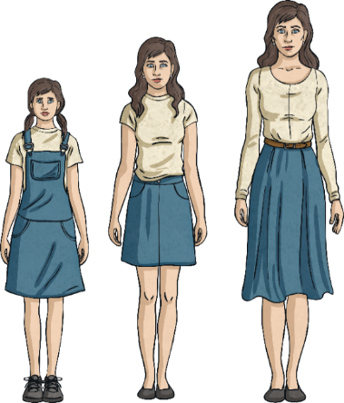
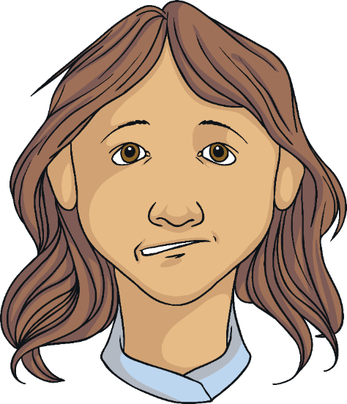
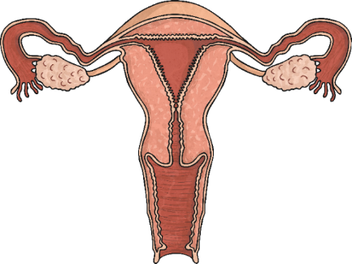
How Bodies (and Emotions)
Can Change During Puberty
Puberty usually starts between the ages of 8 and 13 in females.
Let’s take a look at some changes that happen in the female body
during puberty…
Girls might notice that they have white or clear fluid coming from their vagina. It might be thin and wet or thick and sticky. This is nothing to worry about. It is called discharge and it’s just another sign that hormones are changing your body.
The female body makes and stores eggs in the ovaries. When these are not fertilised, they leave the body. This is called menstruation or ‘periods’.
The female body gets curvier, as the hips get wider and breasts develop.

Slide 15
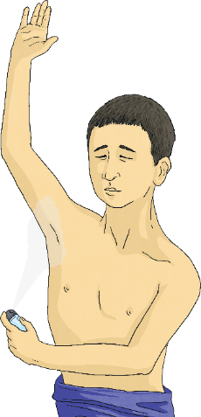

How Bodies (and Emotions)
Can Change During Puberty
So, male and female bodies both go through some changes that don’t happen to the other gender.
However, there are some changes that both boys and girls can experience.
The hormones stimulate the glands in your skin, including the sweat glands under your arms. This can cause body odour.

Slide 16
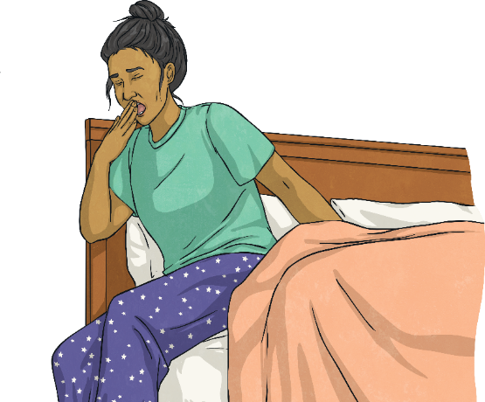
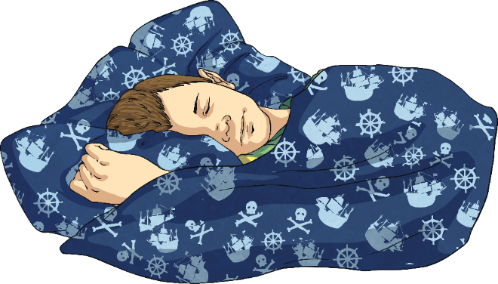
How Bodies (and Emotions)
Can Change During Puberty
Another change that young people might experience when they go through puberty is called nocturnal emissions, or wet dreams.
Males and females can experience wet dreams and, as you might have guessed from the word 'dreams', they happen when we are asleep.

Slide 17


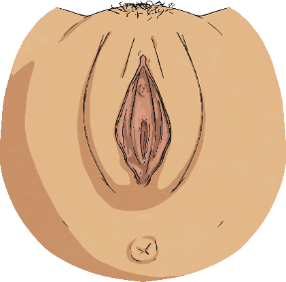
How Bodies (and Emotions)
Can Change During Puberty
If you have a penis, you might ejaculate semen (the fluid containing sperm) from your penis in the night.
If you have a vulva, you might notice it becomes wet in the night from some discharge.
You might be dreaming about something of a sexual nature or you might not remember what you were dreaming about at all. Either way, wet dreams are nothing at all to worry about. They are completely normal but not everyone experiences them.

Slide 18
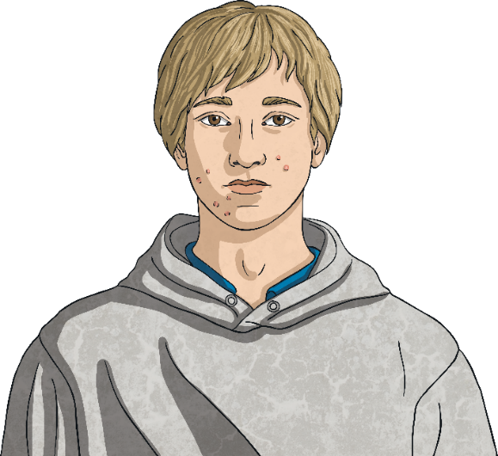
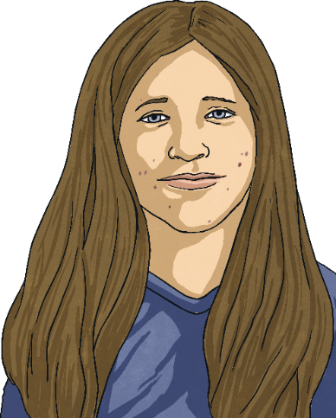
How Bodies (and Emotions)
Can Change During Puberty
Some young people develop acne (pimples or spots) as their skin gets oilier. These might be on the face, upper-back or upper-chest.
It’s important not to pick spots. Just try to keep your face and body clean. If they get particularly bad, you could get some medical
treatment, such as facial
wash, cream or gel.

Slide 19
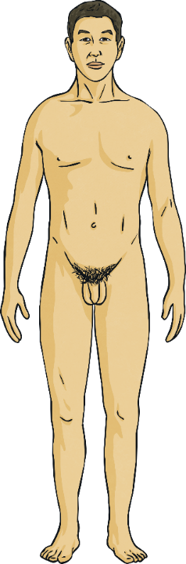
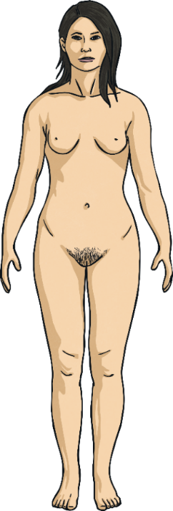
How Bodies (and Emotions)
Can Change During Puberty
Under-arm hair and pubic hair (hair around the genitals) begins to grow.
Some people choose to trim or remove some or all of their body hair but you don’t have to. It’s up to the individual. If you do decide to remove body hair, get help to make sure you do it safely and hygienically.

Slide 20
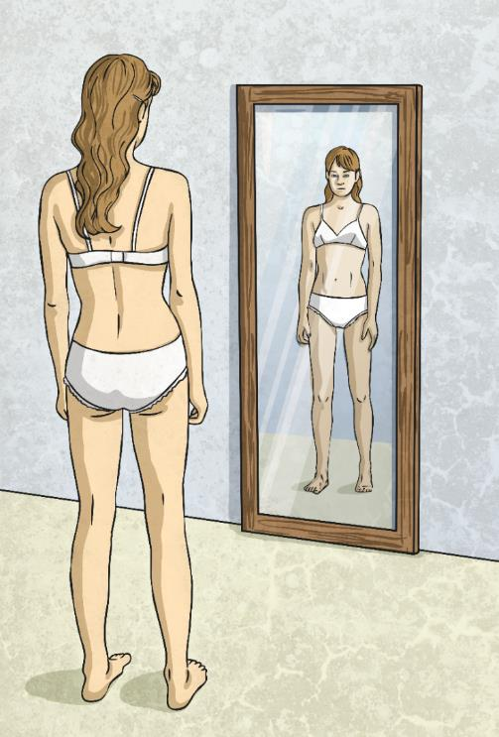
How Bodies (and Emotions)
Can Change During Puberty
Getting to Know Your Own Body
It’s important that you find out about your own body and feel comfortable with it. It’s your body, so it’s OK to look at it and touch it.
As young people develop, they sometimes like to touch themselves. This is called masturbation. Masturbation can be a way of exploring your body and any new feelings you may have.
Masturbation is a private thing but it is completely normal and safe.

Slide 21

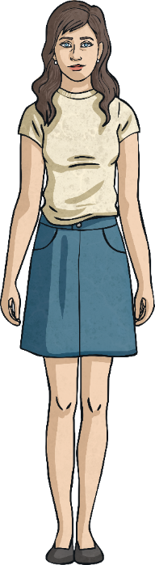
How Bodies (and Emotions)
Can Change During Puberty
All girls and boys go through these changes as they become women and men.
These changes happen at different times for different people. Some people may start puberty before or after their friends.
This is completely normal and no reason to worry. There is no ‘right’ or ‘wrong’ time to start puberty!
Do you have any questions?

Slide 22

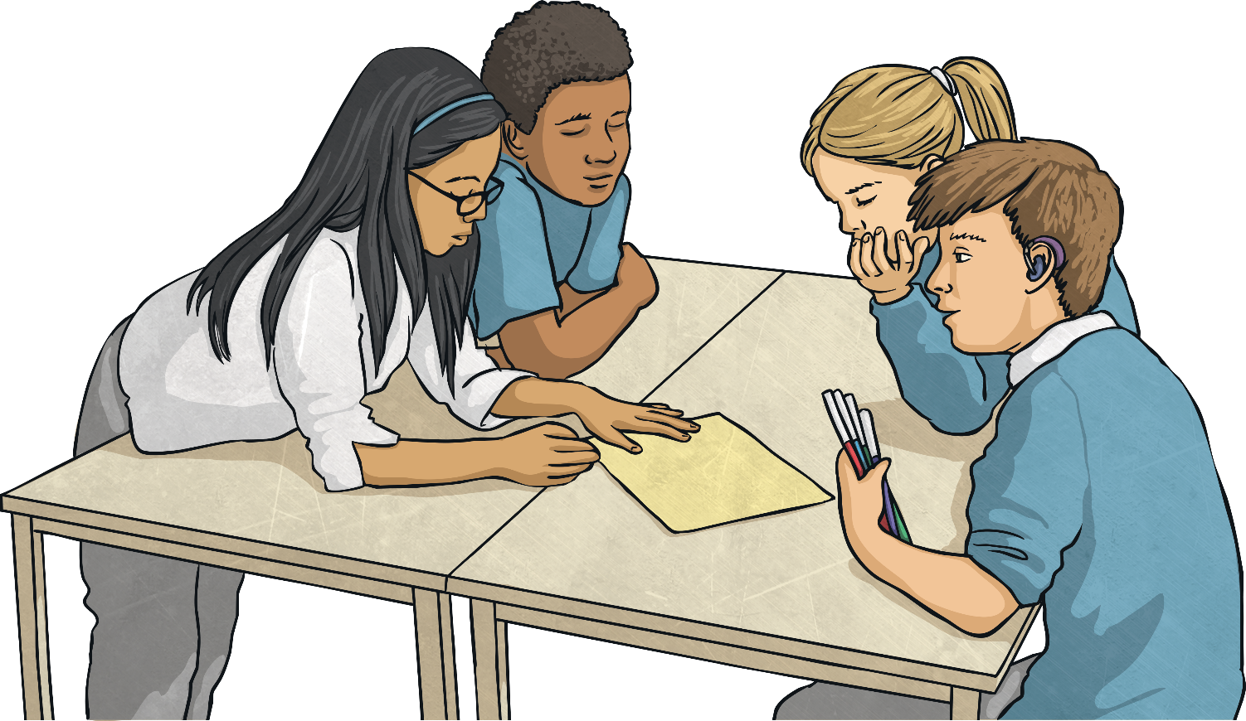
Looking After Our
Changing Bodies
Thinking about all of the changes peoples’ bodies go through during puberty, work in a small group to think of ways that young people can look after their bodies as they are changing.

Slide 23


Looking After Our
Changing Bodies
What ways did you think of for young people to look after their bodies during puberty?
Wash well!
Eat healthily!
Wash often!
Ask for advice!
Chat to friends about the changes!
Wear comfortable underwear!
Leave spots alone!
Use deodorant!
Get plenty of sleep!
Be prepared!
Get lots of exercise!

Slide 24
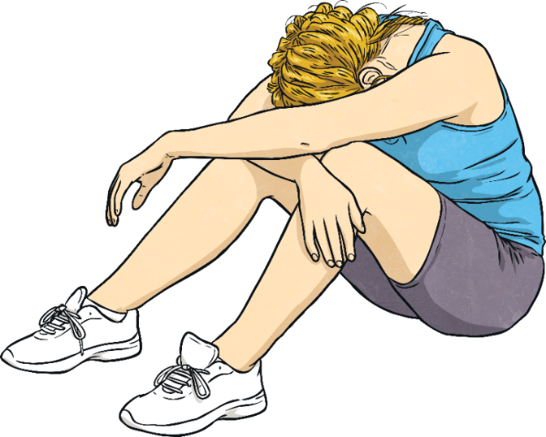
Looking After Our
Changing Bodies
Your body – before it changes, during puberty and after it has changed – is YOUR body.
You have the right to protect yourself against any inappropriate or unwanted contact. Others should respect you and your body.
If you ever have any concerns about someone wanting to do something to your body, you should report it to an adult you trust. They could advise you and get the help and support you need.
Take care of your body and stay safe.

Slide 25
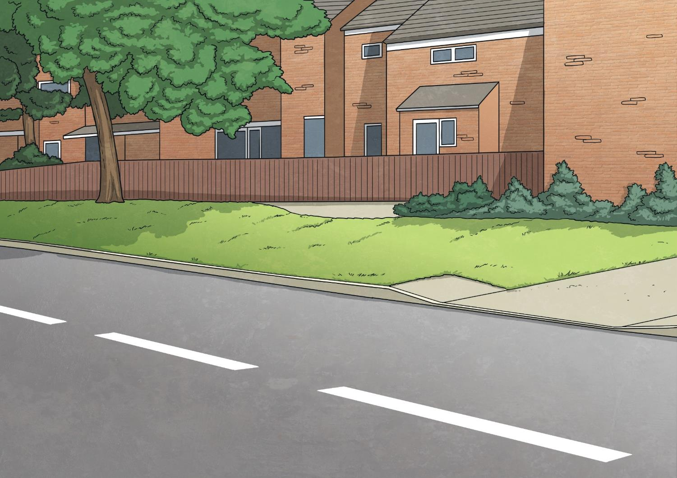
Consolidating
Reflecting

Slide 26
Consolidating

Slide 27

How to Look After Your
Body During Puberty
Create a fact sheet using the Changing Bodies Activity Sheet to give advice to others about how to look after their bodies during puberty.
Make your fact sheet colourful and eye-catching.
Try to include a message about inappropriate or unwanted contact.
Make sure you include accurate, useful information.
Think about the layout and include pictures, captions and text boxes.
Will your fact sheet be aimed at just girls, just boys or everyone?
Try to include at least three tips for looking after your body as it changes.

Slide 28
Reflecting

Slide 29

Advice and Support
So, what have we learnt about the ways in which our bodies change during puberty? What have you learnt about the ways that we can look after ourselves as our bodies change?
Summarise your learning with your talk partner.
Imagine that you had a friend who was finding puberty difficult to cope with.
What advice would you give them?

Slide 30
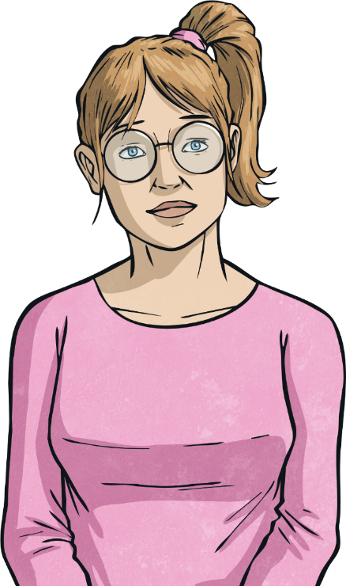
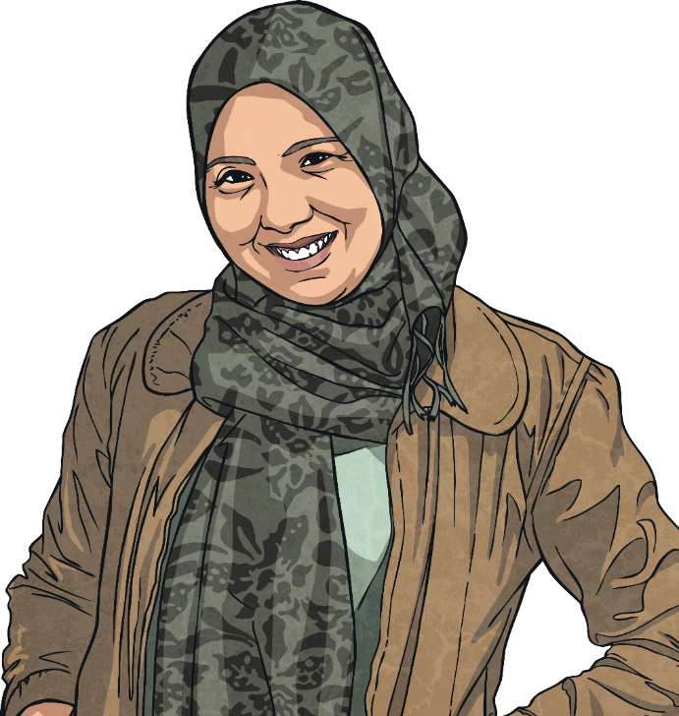



Advice and Support
There might be times, as your body changes, when you have questions you’d like to ask. You might want to talk about the physical or emotional changes you are going through and you might want some advice and support.
There are also trustworthy websites and useful books available to provide accurate information.
You might have people in your family that you could talk to.
You could speak to an adult at school.
You could speak to a nurse or doctor about some concerns.
Who might you be able to speak to for advice and support if you need it?

Slide 31
The Big Questions

Slide 32
What are the changes that occur in boys’ and girls’ bodies during puberty?
How can we look after our changing bodies as we grow?

Slide 33
Aim
I can describe the changes that people’s bodies go through during puberty and how we can look after our changing bodies.
Success Criteria
I can use scientific vocabulary when talking about the human body.
I can discuss changes my body will go through and I know what
to expect.
I can explain how to look after my changing body.
I can explain how to protect my body and stay safe.
This resource is fully in line with the Learning Outcomes and Core Themes outlined in the PSHE Association’s Programme of Study.

